Slide 1

SQLALCHEMY
LIFECYCLE

Slide 2
SQLAlchemy Recap
Basics
SQLAlchemy is a library for working with relational databases from Python.
It is a type of an Object-Relational Mapping library that enables you to use object-oriented programming to interact with databases.

Slide 3
SQLAlchemy Recap
Advantages of SQLAlchemy
Allows SQL clauses to be built via Python functions and expressions.
Avoid writing raw SQL.
You can avoid sending SQL to the database on every call. The SQLAlchemy ORM library features automatic caching, caching collections, and references between objects once initially loaded.

Slide 4
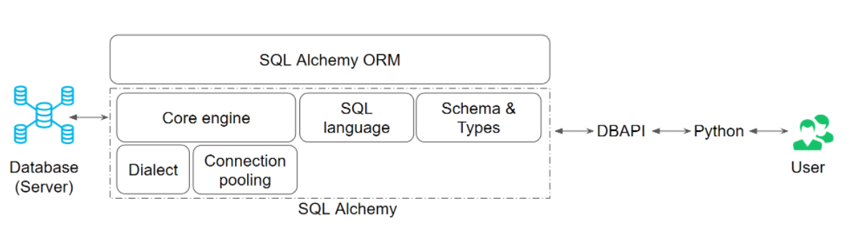
SQLAlchemy Recap
Bigger picture of where SQLAlchemy and ORM are

Slide 5
SQLAlchemy Recap
Summary of Basics
Our purpose with SQLAlchemy is to make our code more Pythonic by:
working in classes, models and objects and writing less and less raw SQL.

Slide 6
SQLAlchemy Recap
SQLAlchemy ORM
How exactly do we map database schema's to application's Python objects?
Table maps onto a Class
Column maps onto a Class Attribute
Row maps onto an Instance of a class

Slide 7
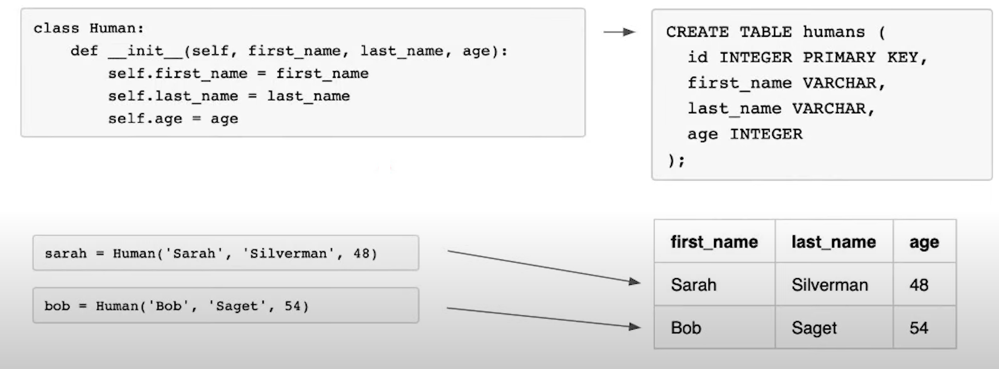
SQLAlchemy Recap
Eg of SQL command to SQLAlchemy ORM

Slide 8
SQLAlchemy Recap
Defining Models
db.Model lets us create and manipulate data models.
Eg, class MyModel(db.Model) will inherit from db.Model
By inheriting from db.Model, we map from our classes to tables via SQLAlchemy ORM

Slide 9
SQLAlchemy Recap
Defining Models
Defining columns
Within our class, we declare attributes equal to db.Column(<datatype>,<primary_key?>,<constraint?>, <default?>)
Eg,
db.Column(db.Integer, primary_key=True)

Slide 10
SQLAlchemy Recap
Defining Models
Table naming
By default, SQLAlchemy picks the name of the table for you, setting it to the lower-case version of your class's name. Otherwise, you can set the name of the table using __tablename__ = 'my_custom_table_name'.

Slide 11
SQLAlchemy Recap
Defining Models
Complete version of our defined model:
class Student(db.Model):
__tablename__ = 'persons'
id = db.Column(db.Integer, primary_key=True)
name = db.Column(db.String(), nullable=False)

Slide 12
SQLAlchemy Recap
Data Types
db.Integer
db.String, specifies a varchar data fields
db.Text, for longer text
db.DateTime, for date time objects
db.Float, for floating point values
db.Boolean, for boolean values
db.PickleType, for converting an object to a byte stream
db.LargeBinary, for storing large binary data (pickled objects).

Slide 13
SQLAlchemy Recap
Model.query
SQLAlchemy includes querying methods eg, count(), all(), first(), delete(), etc.
You can chain an indefinite number of query objects.
You can run:
1. MyModel.query.method() directly on the model
2. db.session.query(MyModel) using db.session.query

Slide 14
SQLAlchemy Recap
Model.query
Eg, Person.query.all() which is similar to SQL SELECT * on the Person model.

Slide 15
SQLAlchemy Object Lifecycle
Proposed data changes are not immediately committed to the database once we define them.
These changes have to go through certain are stages before being committed to allow for undos.

Slide 16
SQLAlchemy Object Lifecycle
Flush - An event that takes pending changes and translates them to SQL commands ready to be committed to the db.
It is not the same as a commit because nothing is yet pushed to the db when a flush happens, we'll still need to call a commit after a flush.
Eg of when a flush occurs:
When calling a query eg Person.query.all()

Slide 17








SQLAlchemy Object Lifecycle
Stages before a commit
Stage 1: Transient
Stage 2: Pending
Stage 3:Flushed
Stage 4: Committed

Slide 18

SQLAlchemy Object Lifecycle
Stages before a commit
Stage 1
Transient
An object has been defined, but has not yet been attached to a session or database, eg
user1 = User(name='Abu')

Slide 19
SQLAlchemy Object Lifecycle
Stages before a commit
Stage 2
Pending
An object was attached to a session.
"Undo" becomes available via db.session.rollback(), we can clear any work that has been done so far.
An object stays in this state until a flush happens!

Slide 20
SQLAlchemy Object Lifecycle
Stages before a commit
Stage 3
Flushed
Translating changes into SQL commands that are ready to be committed.
Nothing happens in the actual database yet.
The only thing that can do that is 'commit'

Slide 21
SQLAlchemy Object Lifecycle
Stages before a commit
Stage 4
Committed
Manually called for all pending changes to persist to the database permanently.

Slide 22
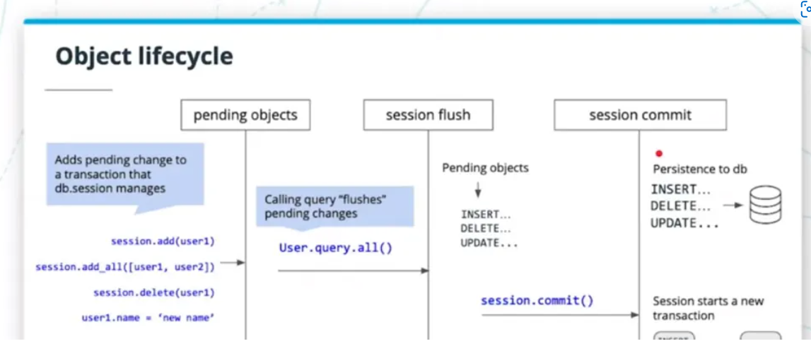
SQLAlchemy Object Lifecycle

Slide 23
Migrations
These deal with how we manage modifications to our database schema, over time.
They are physical files typically stored in our local repository that captures sets of changes to our
database schema

Slide 24
Migrations
What is Flask migrate?
Is an extension that handles SQLAlchemy database migrations for Flask applications
using Alembic.
Schema Migrations are stored in files that keeps track of changes to our database schema.

Slide 25
Migrations
A schema refers to the structure of our database.
Alembic: A library that runs under the SQLAlchemy hood, by executing all the tasks submitted from the SQLAlchemy.

Slide 26
Migrations
To run a migration, you first need to install Flask Migrate using
pip or pip3 install Flask Migrate
To create migrations (in a command line), we use the following commands:
db migrate
This creates migrations script template to fill out
2. db upgrade
This command applies un applied migrations

Slide 27
Migrations
3. db downgrade:
▪ This command rollsback the changes migrations to it previous stage.

Slide 28
Migrations
Flask Script:
This is a script that lets you run migration scripts that were defined from the template.
Advantages of Migrations:
• Auto-detects changes in the DB
• Gives control of changes on the DB

Slide 29
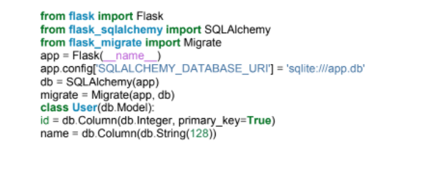
Migrations
Example of an application that handles operations using flask migrate:

Slide 30
Migrations
Every flask application need to start with the following commands to enable migration:
Run flask db init to create a migrations folder if it doesn't exist.
Run flask db migrate to create the migrations.
Run flask db upgrade to commit the changes to the db.
Run flask db downgrade if you would like to undo the changes committed.

Slide 31
THANK YOU FOR LISTENING

